Slide 1

Relay the Message, Reporting What & Why?!
Jessica Handoko

Slide 2






Introduction
DASM & Who we are
Reporting
Documentation
Messaging & Wins
Q & A
Notes:
What to expect?
Intros → a little bit of DASM → Reporting → How we message and some wins → Q&A

Slide 3
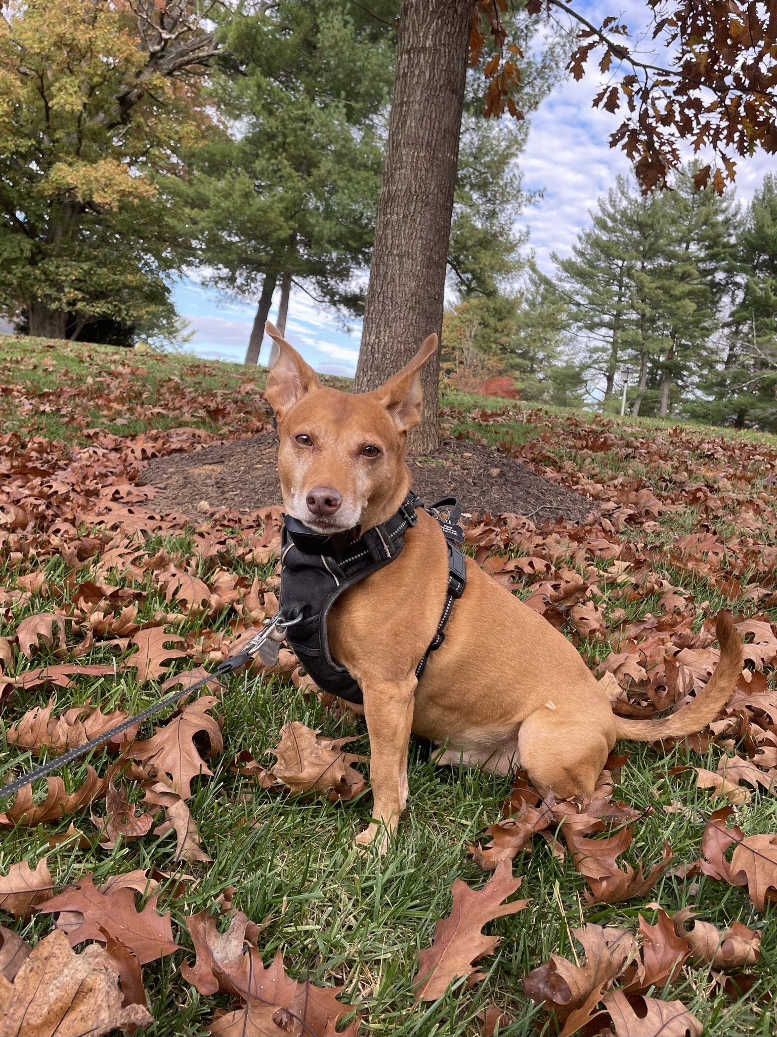
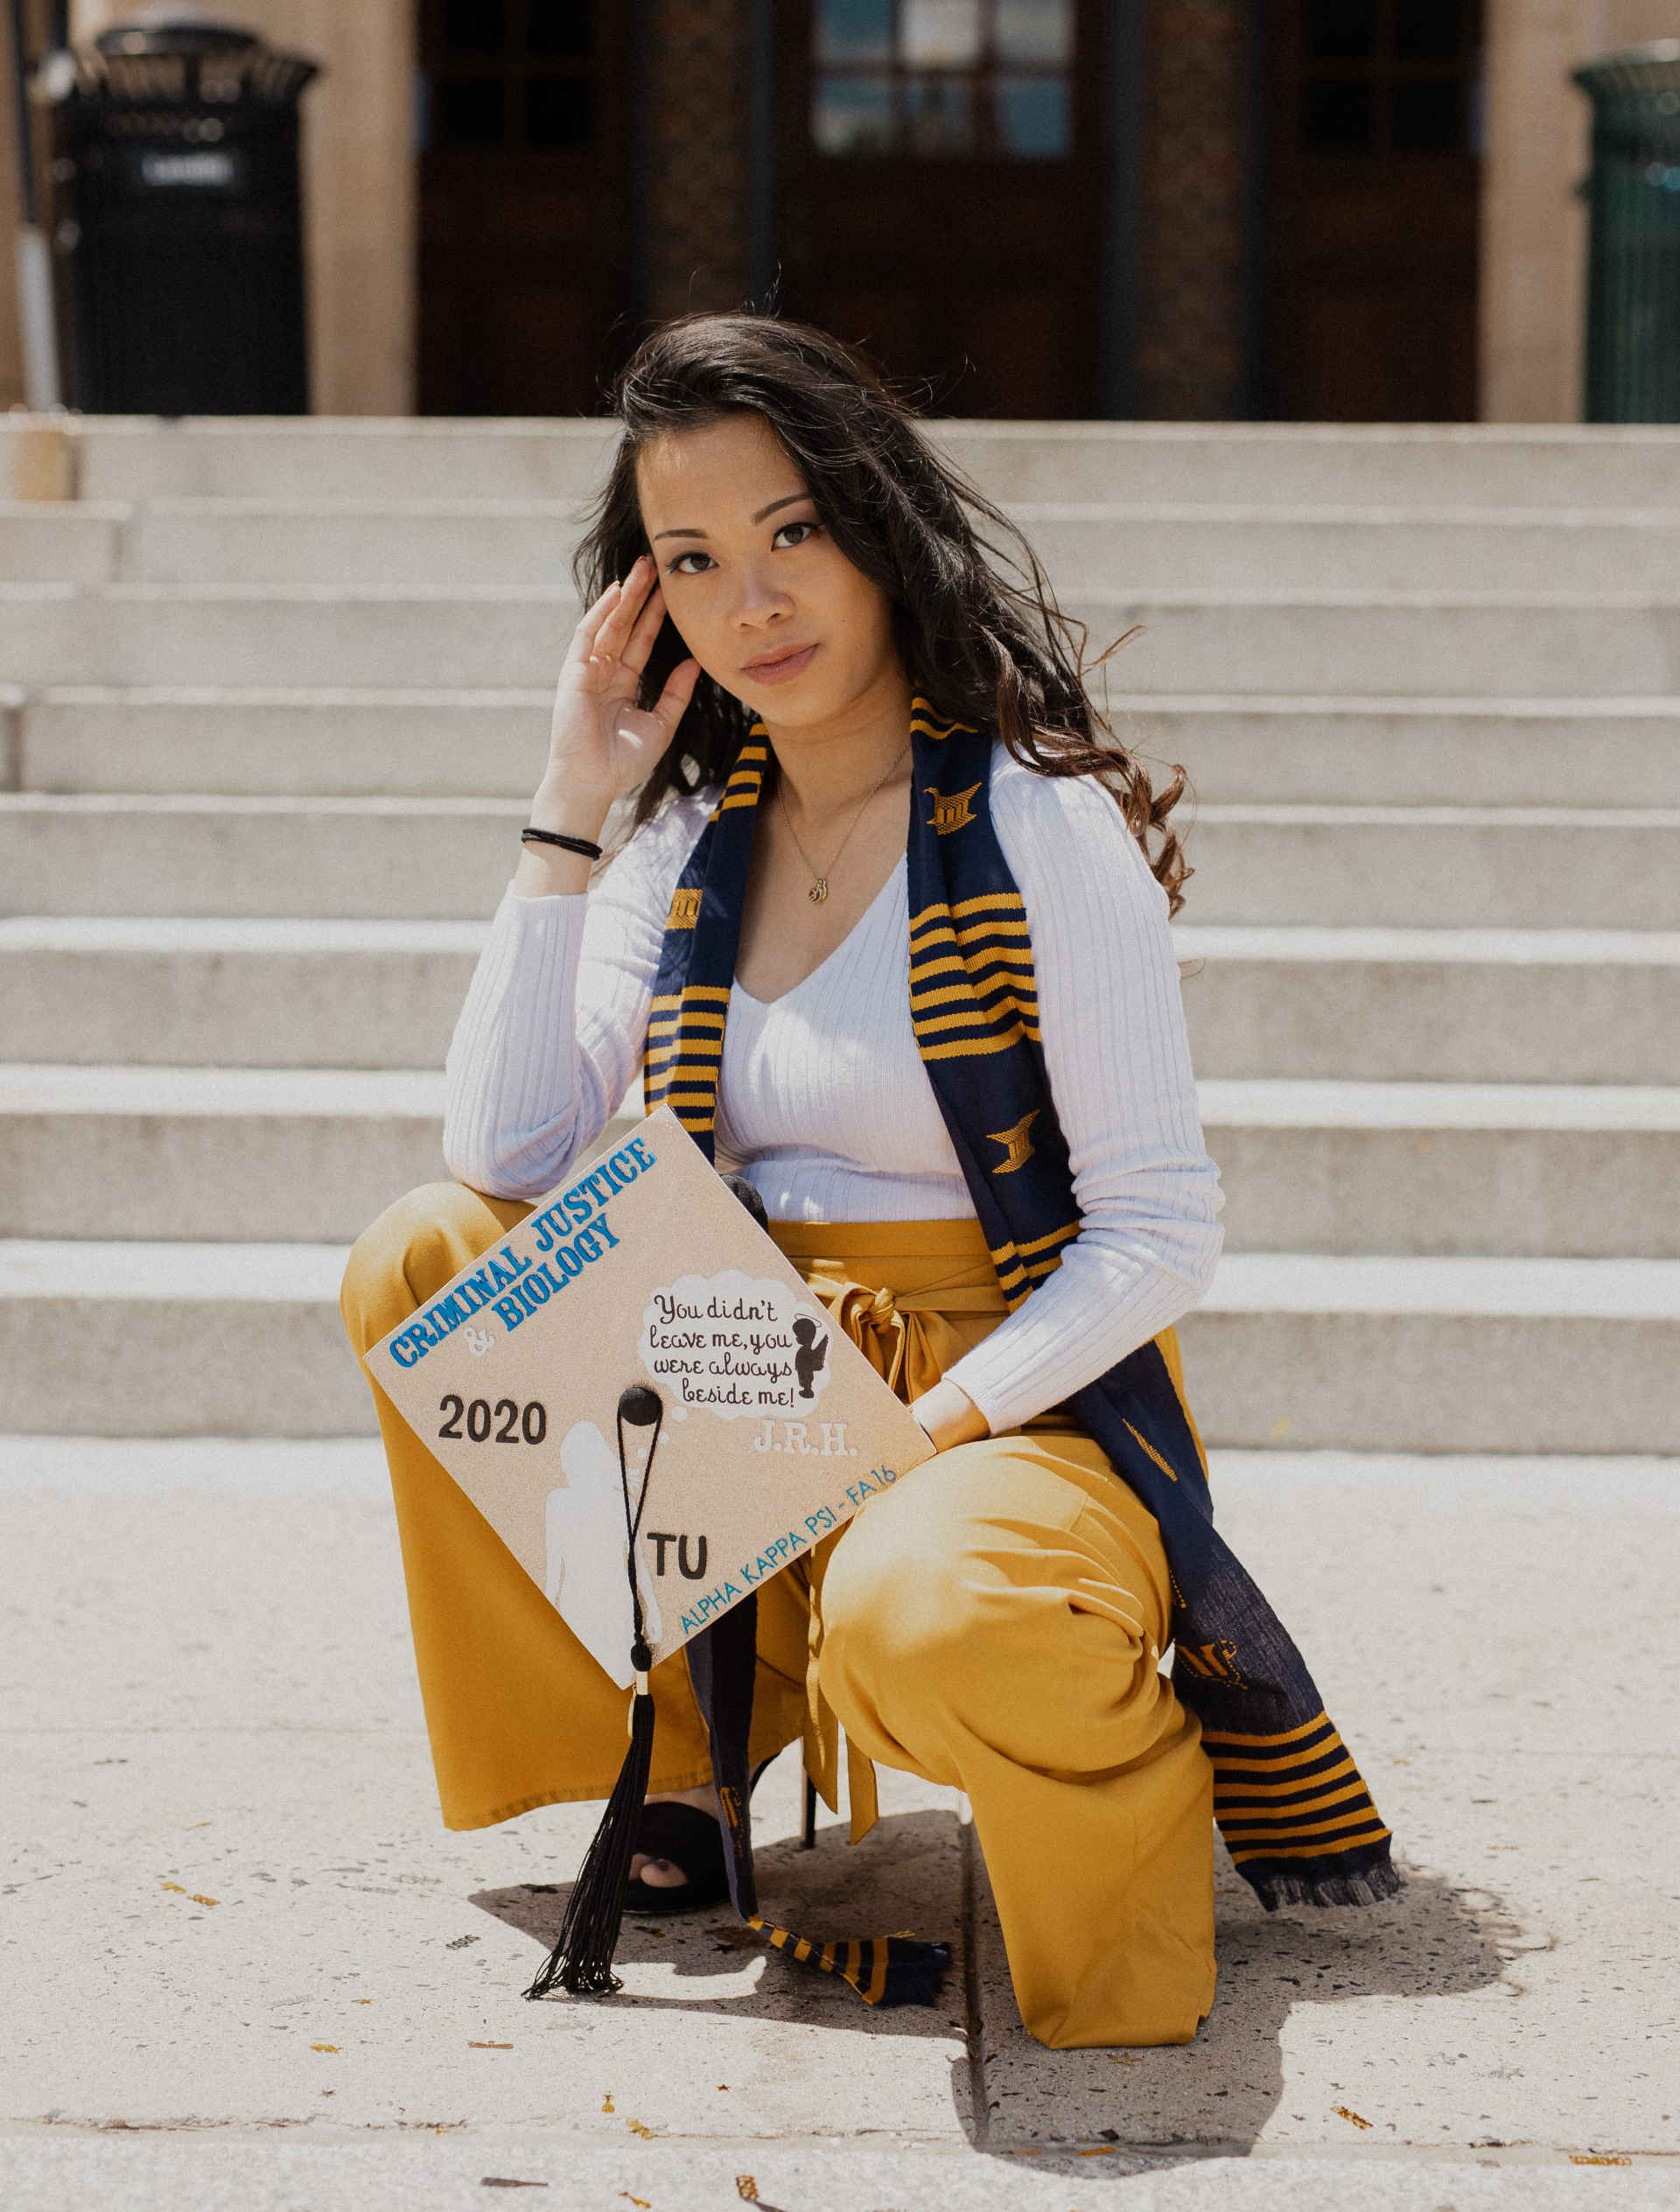
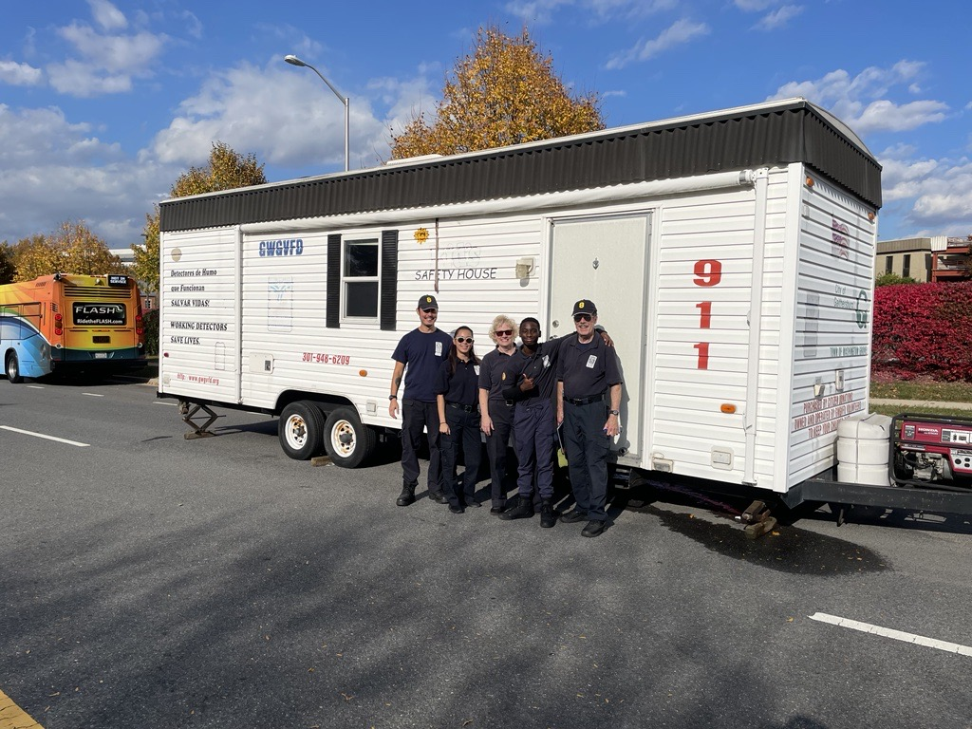
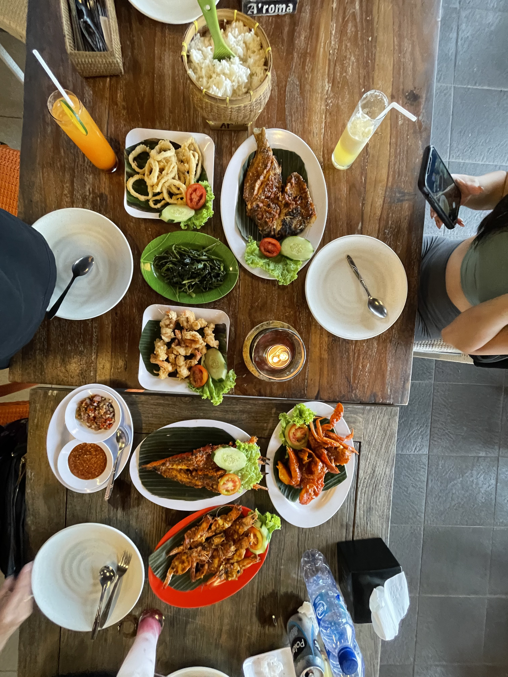
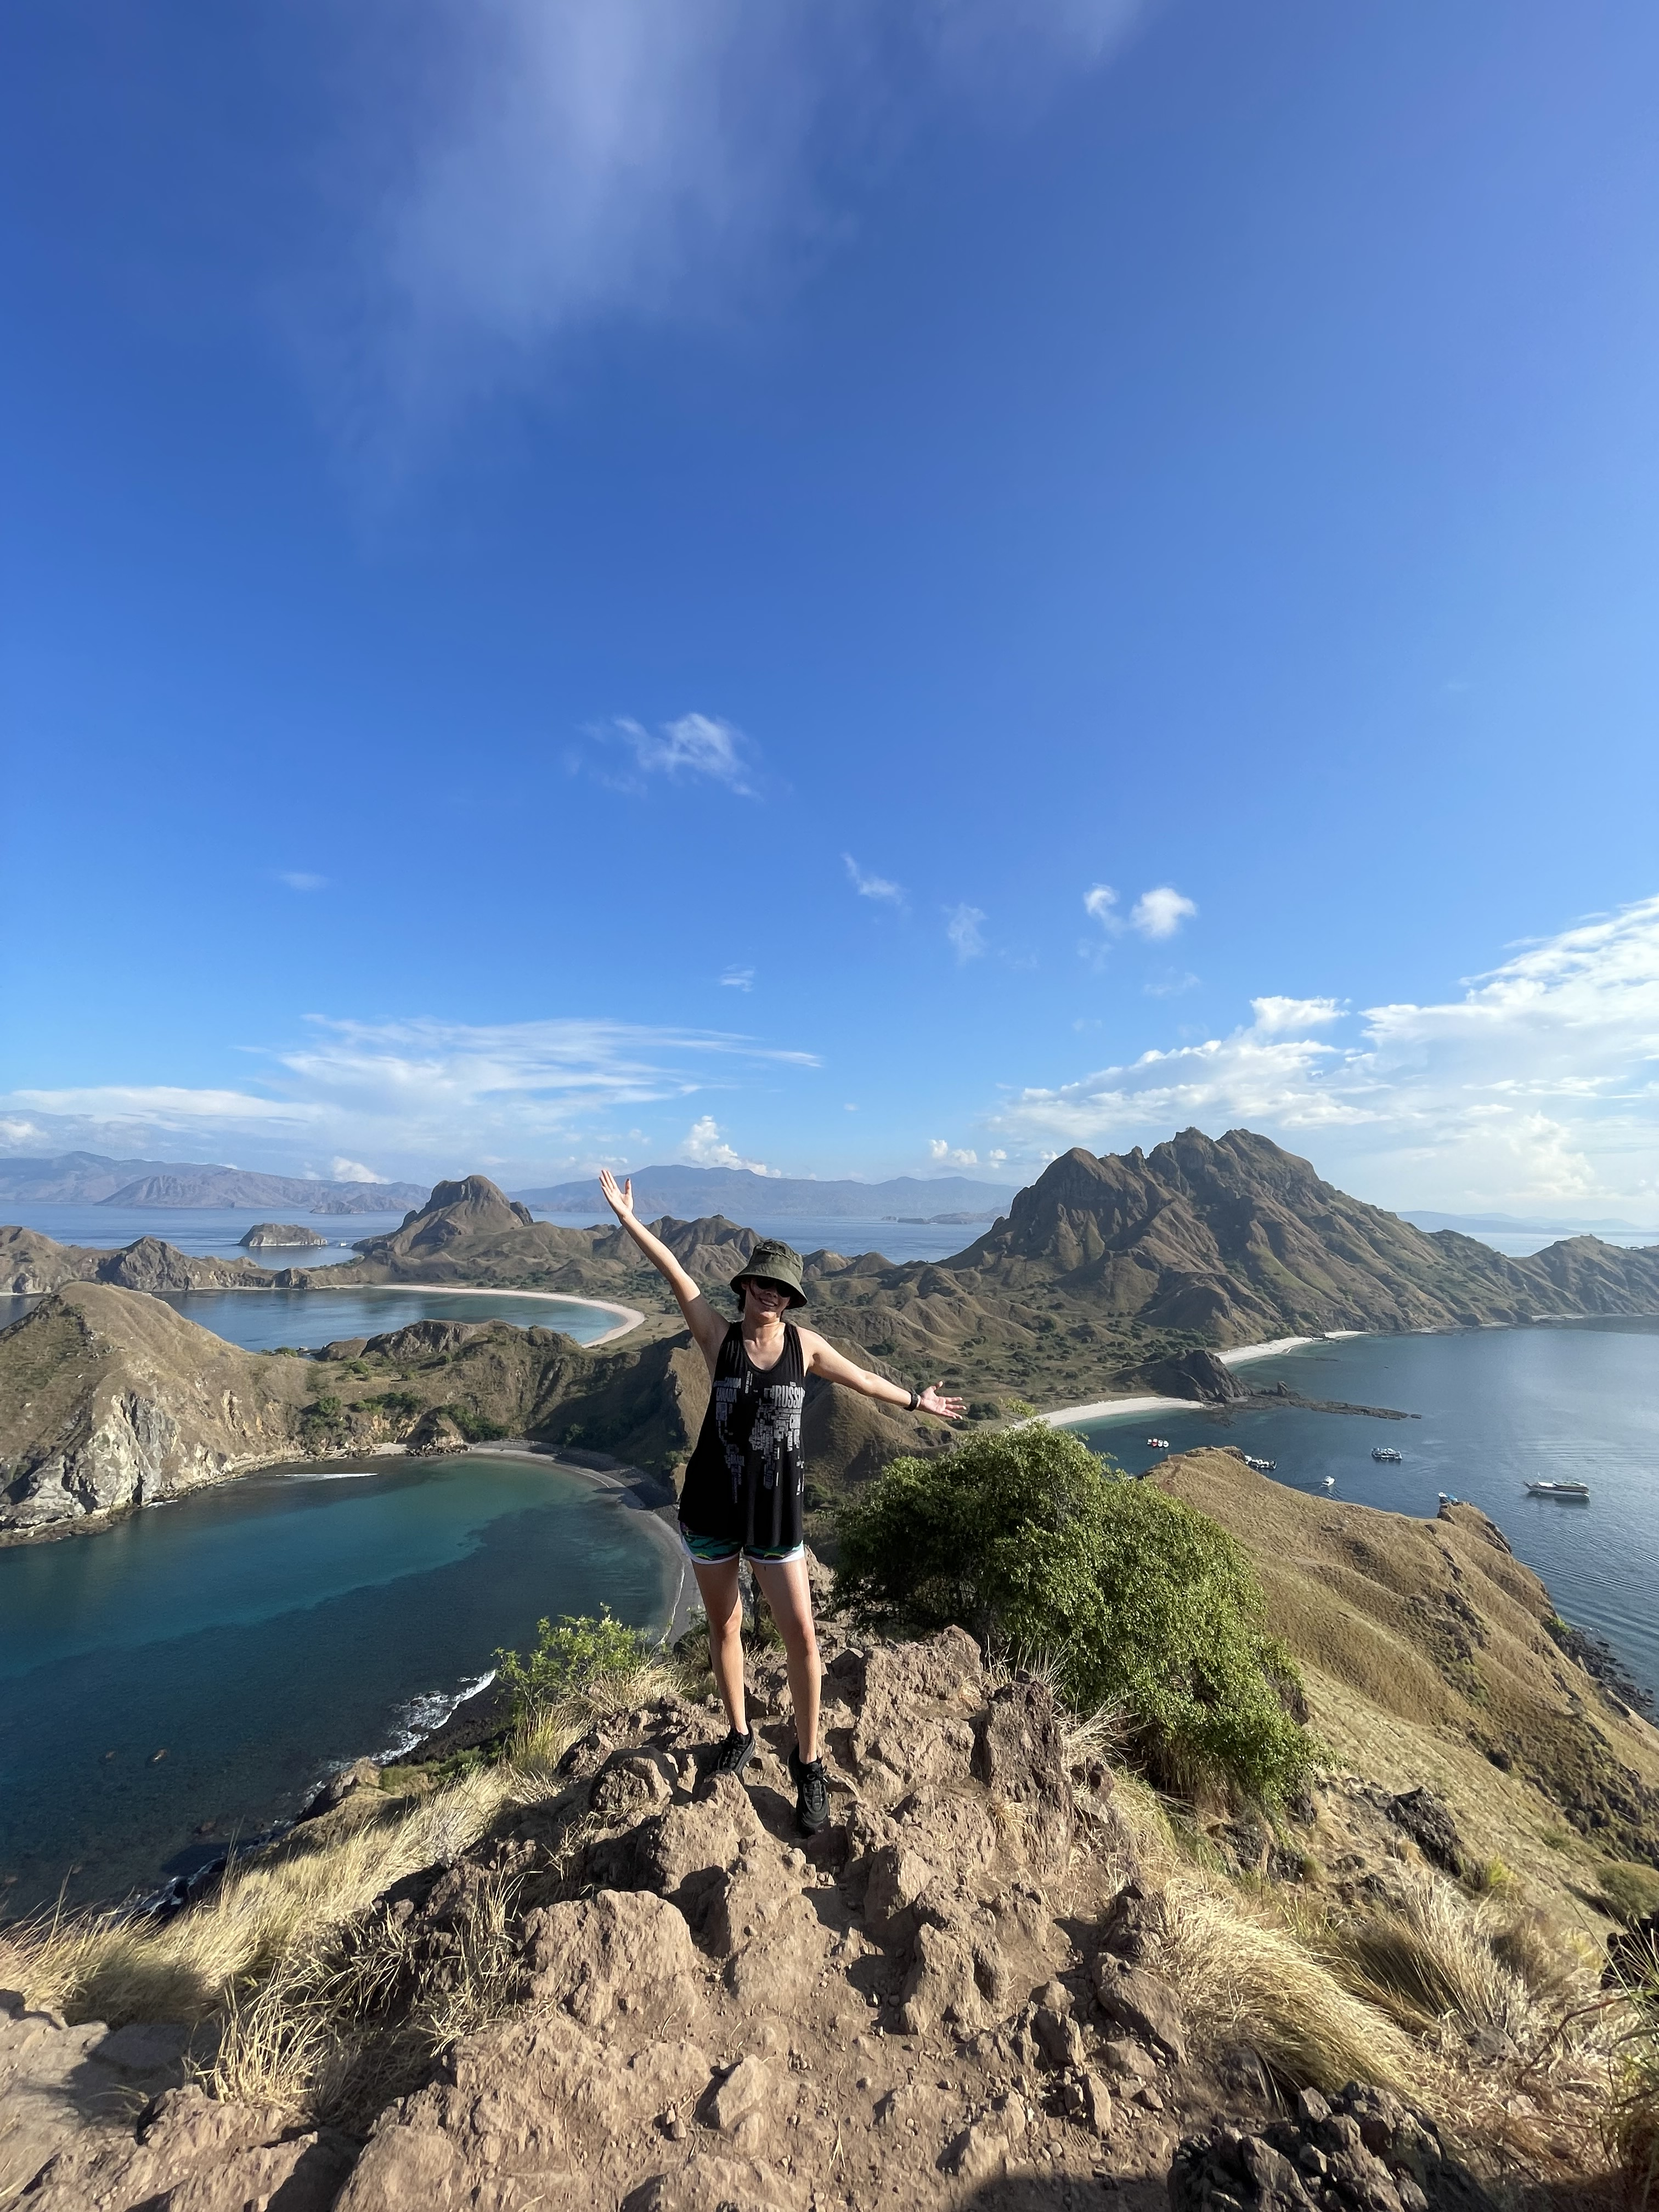
Jessica Handoko
Graduated Towson University 2020
4 years of experience
1 year as a police intern
1 year as a DHHS data administrator
2 years as a fire data analyst
Admin Volunteer with GWGVFD
Proud dog mom
Adventurous foodie
World traveler

Slide 4
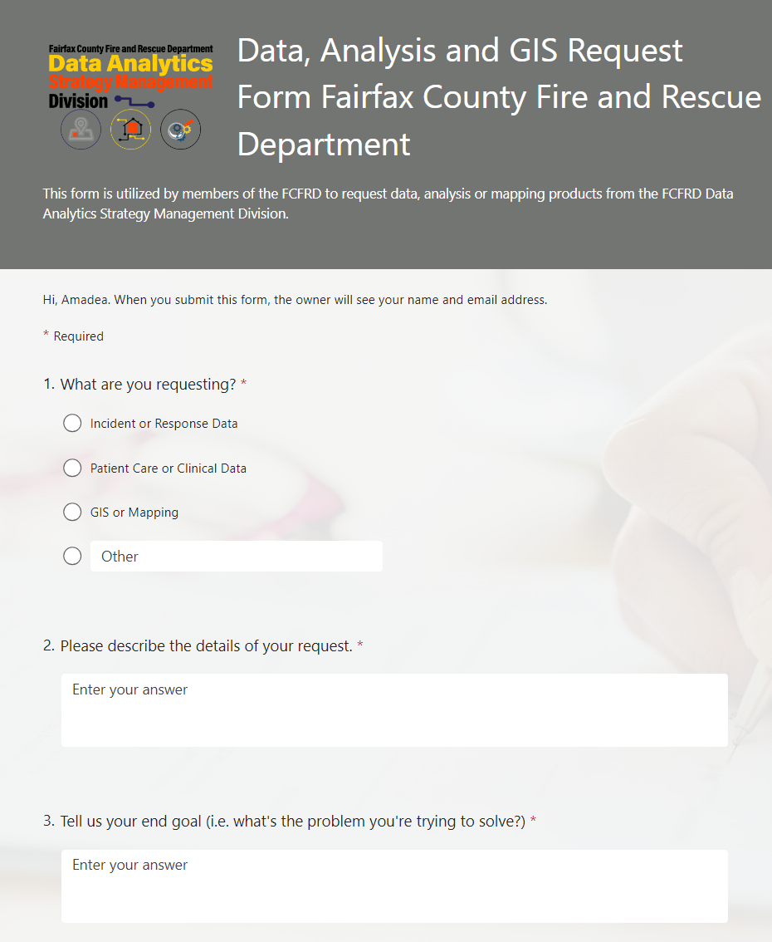
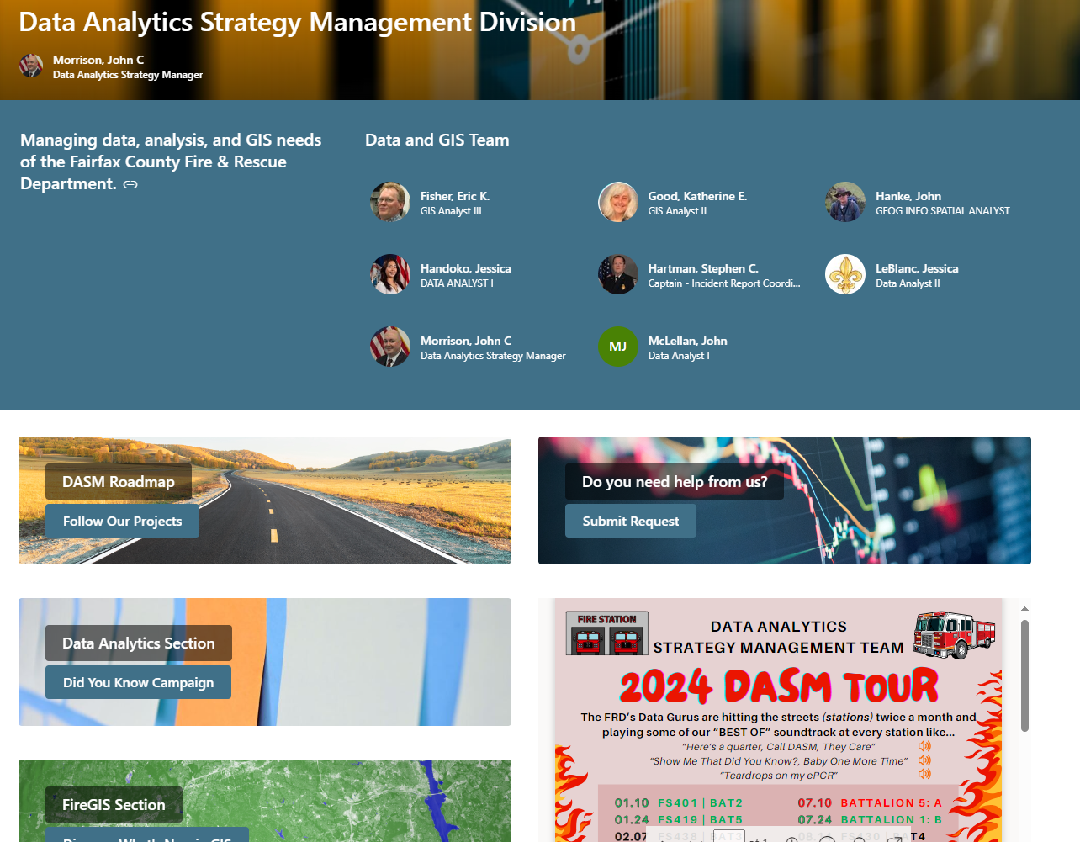
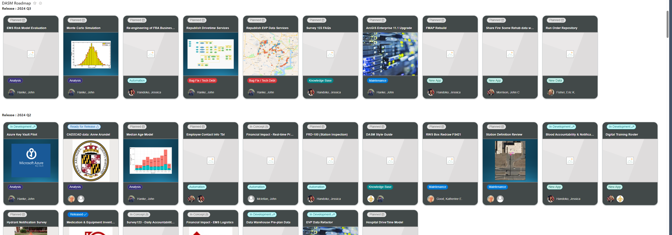
DASM Who Are We & Who Has Access?
Data Analytics Strategy Management Division
In a short sense EVERYONE, and how?
Our DASM request form
SharePoint Site
Group email: Fire-DataAnalytics
Trainings (recruit schools, officer trainings, etc.)

Slide 5
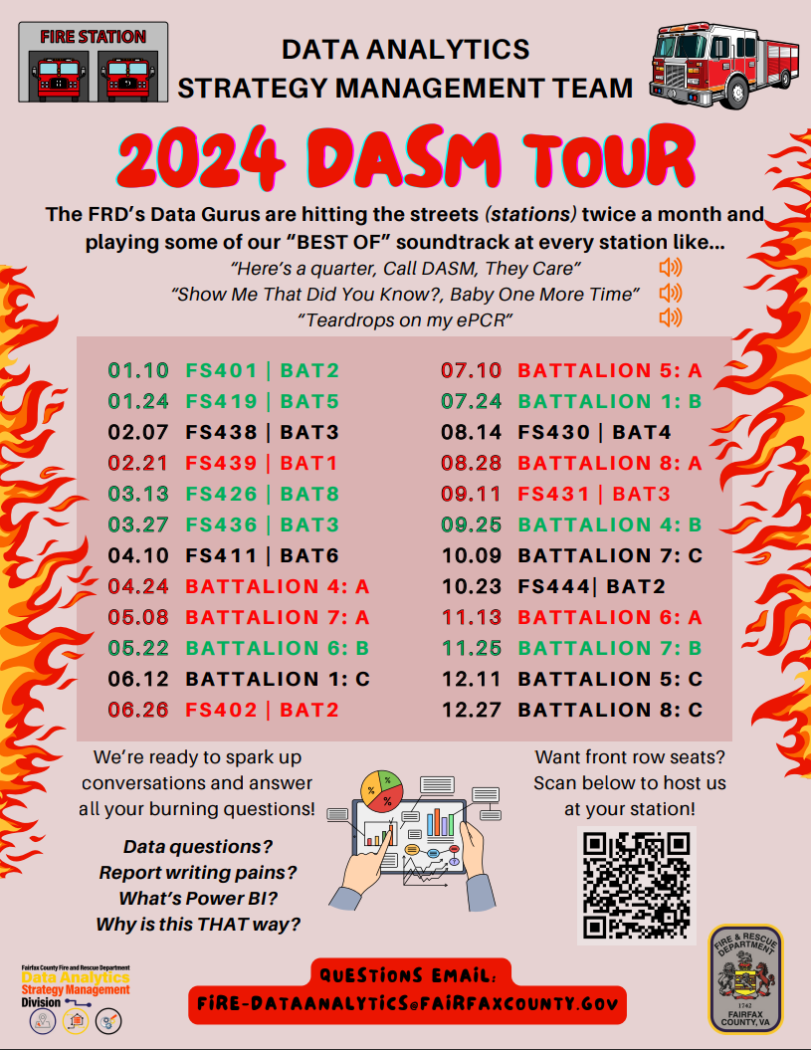

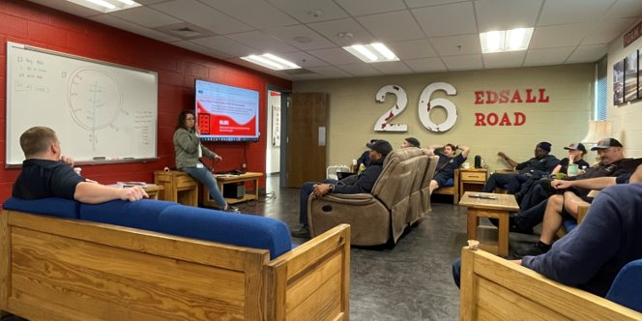
2024 DASM Tour
Idea: How do we get more people to talk about data and understand the why???
How do we try to get in front of every uniform personnel?
Office hours at headquarters???
DASM Station Tours
Gets every battalion and every shift
PLUS FREE BURRITOS!!
STATS
8 Visits
6 Interactive
1 Bomb
1 Cancelled
75% success rate

Slide 6
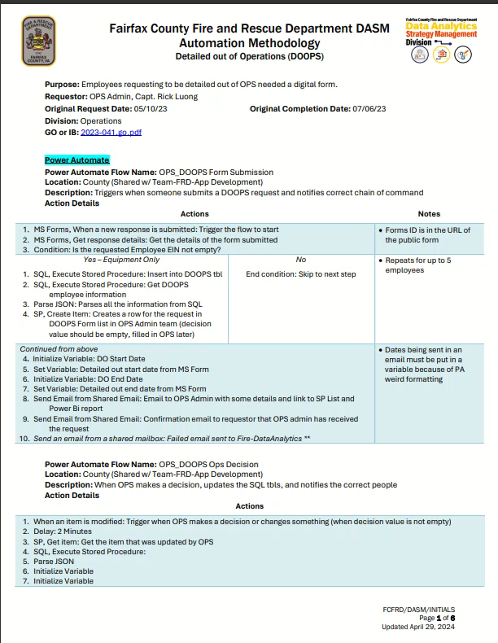

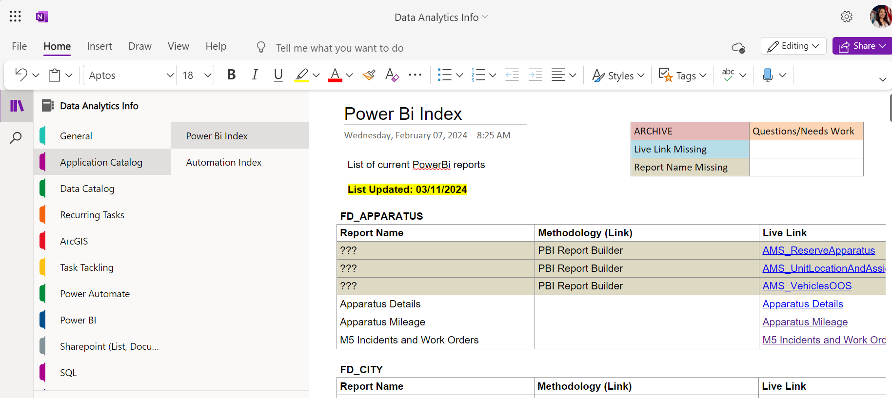
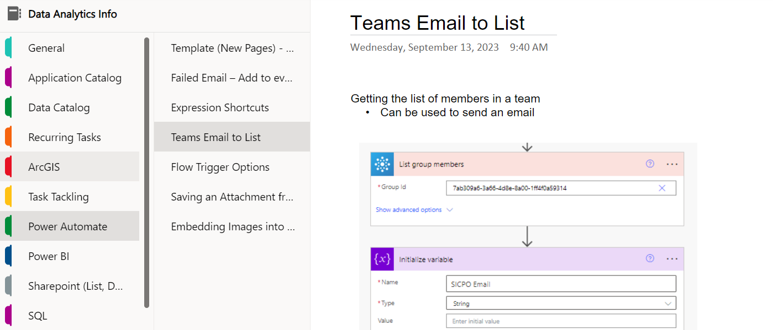
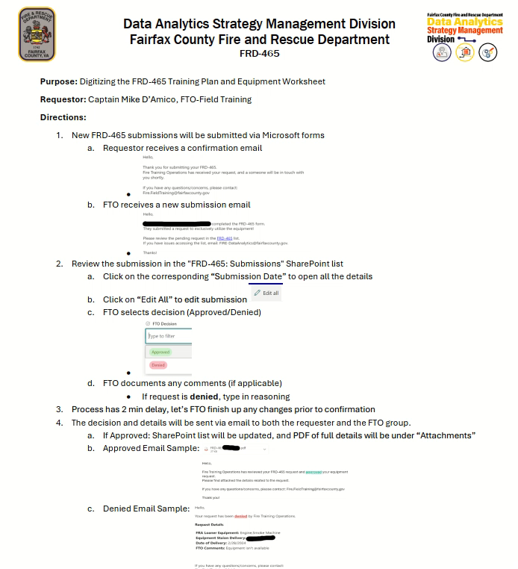
Reporting Templates
DOCUMENTATION DOCUMENTATION!!
Section OneNote
How can we tell the field that we want them to document, if we don’t do the same
Methodology (Automations, PBI)
End User Guides

Slide 7
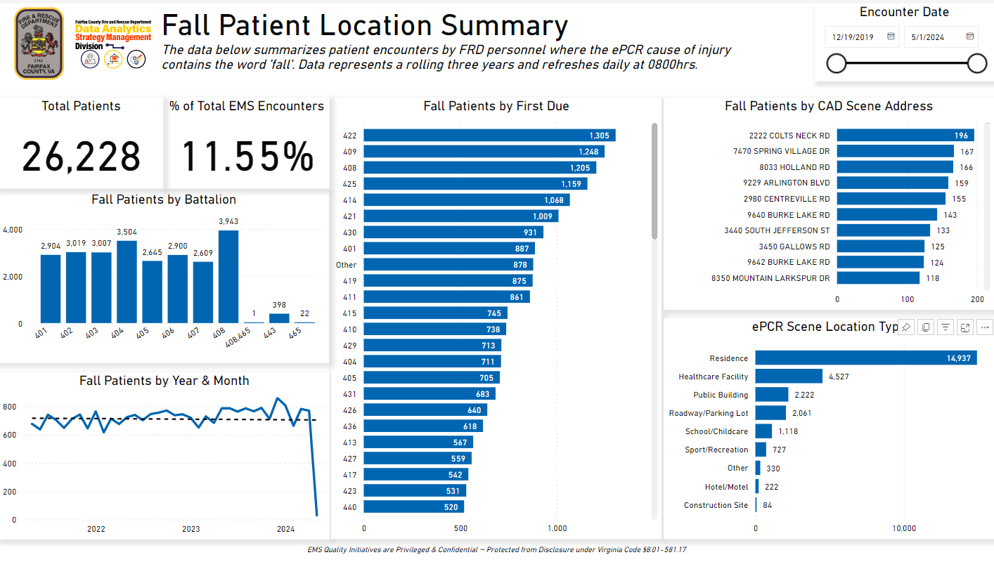
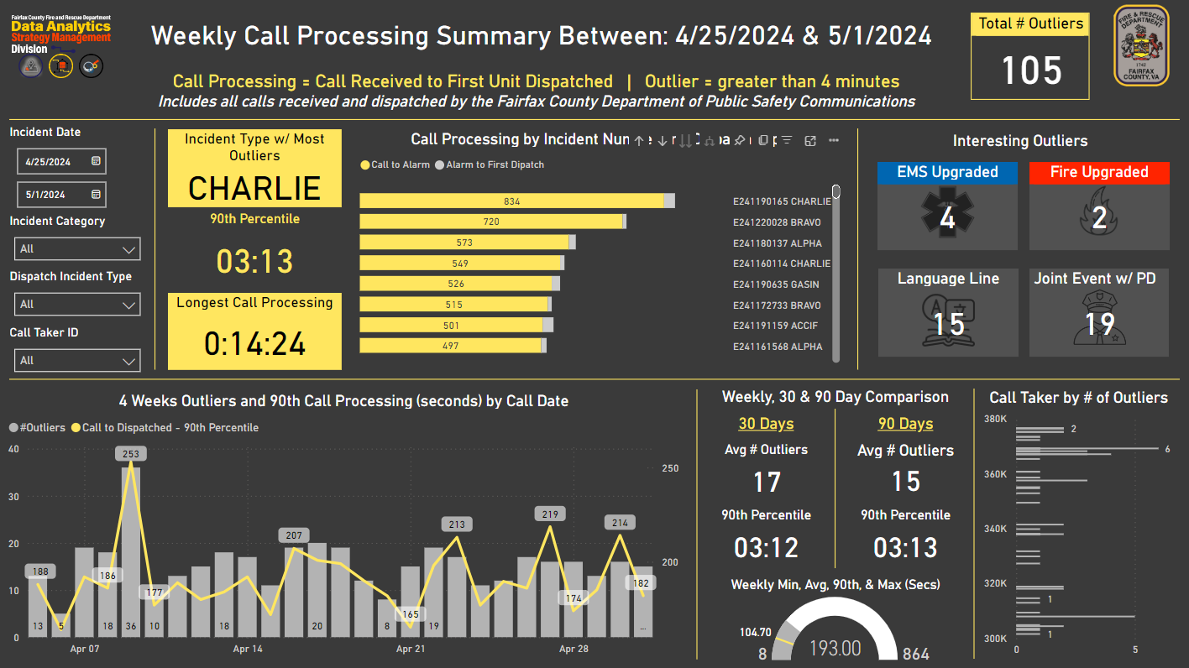
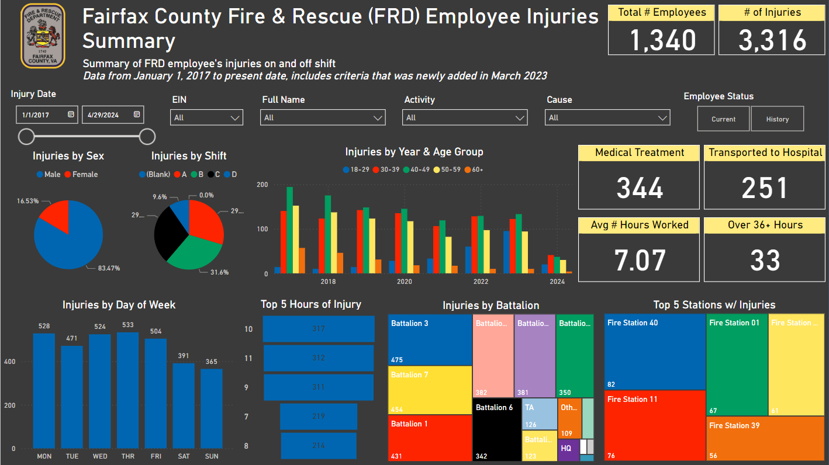
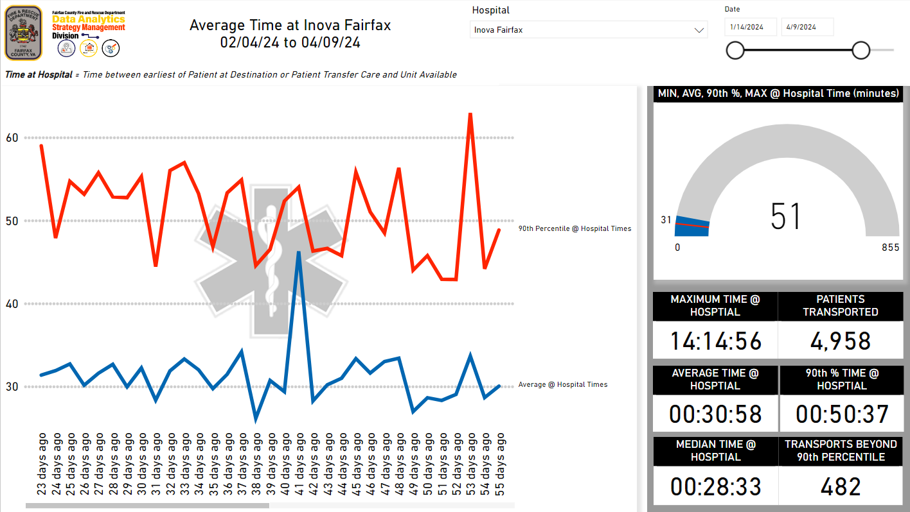
Reporting Templates (PBI)
2 types of reports
Detailed information
General broad information
Power BI Themes
Cleaner and consistent

Slide 8
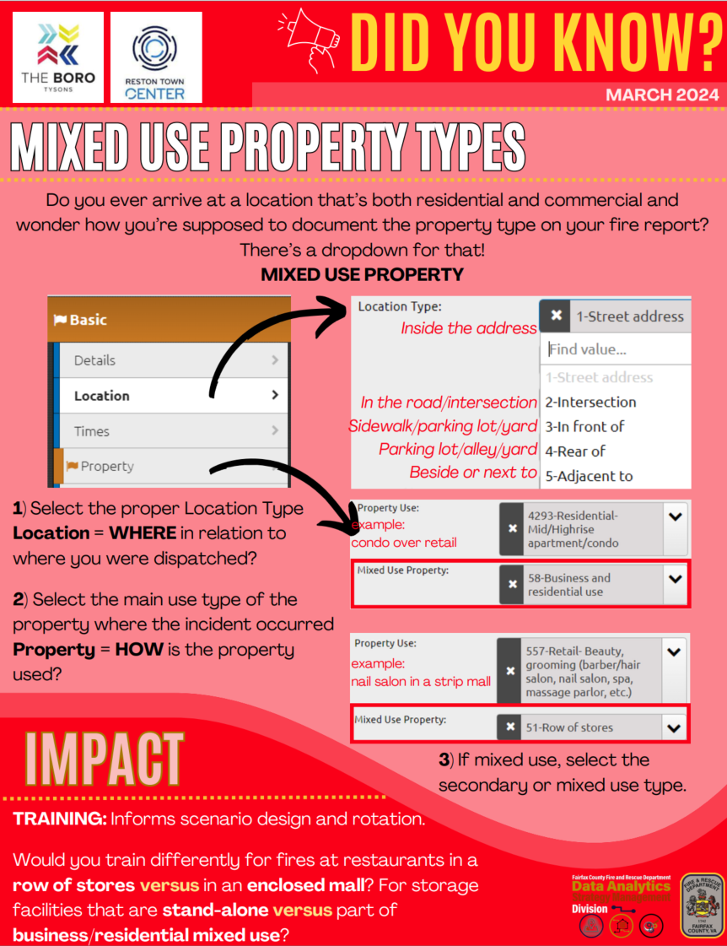
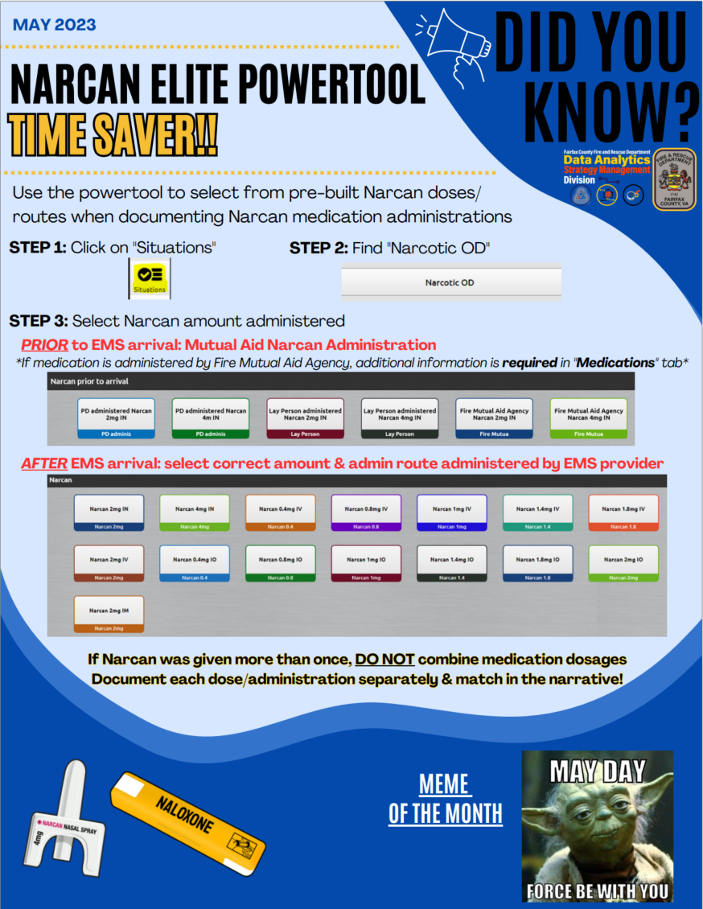
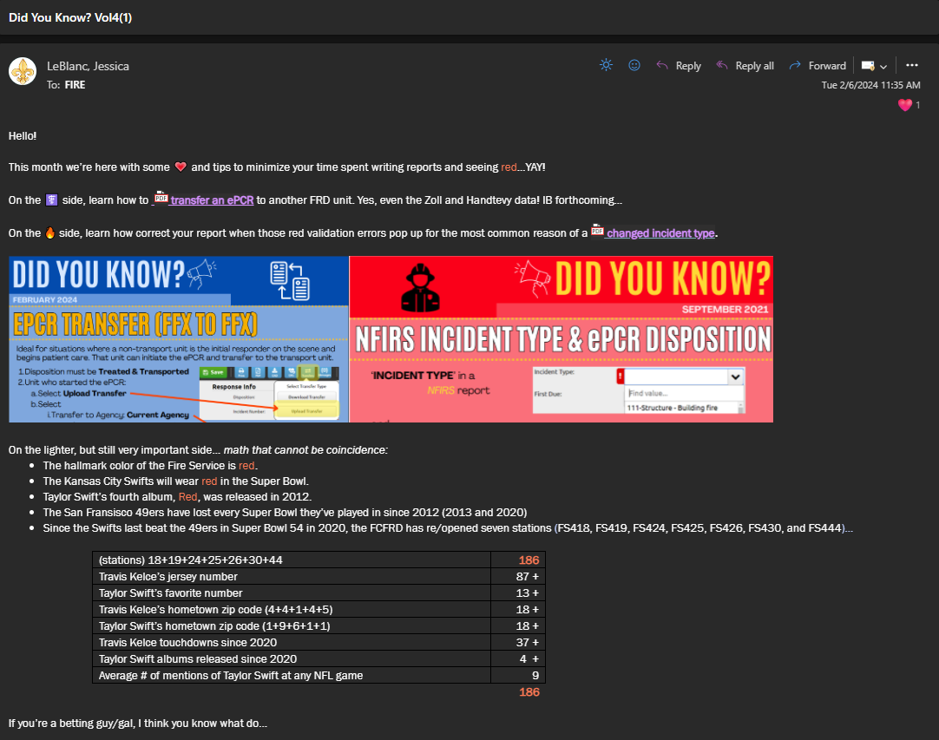
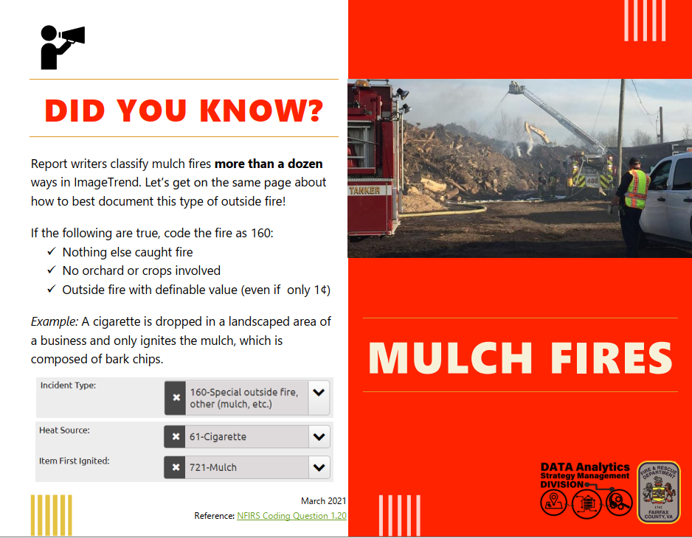
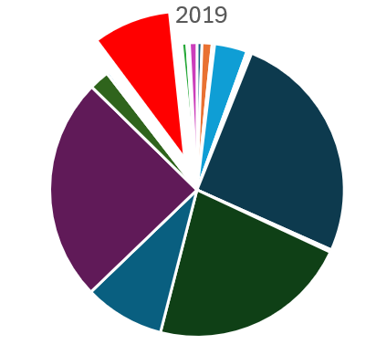
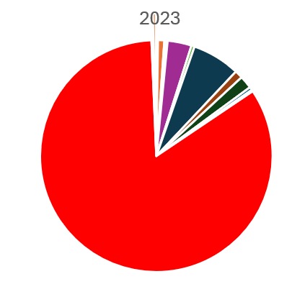
Messaging: Did You Know? Campaign
Started in 2021
Misunderstanding, standards for the department (cohesive)
Ideas directly from the field
THEY DON’T KNOW WHAT THEY DON’T KNOW…
Before QA and Education
After QA and Education
NFIRS 160
9%
NFIRS 160
84%
Notes:
One of the ways we message to the department is our monthly Did you know campaign
It was started by out millenial Jessica (my boss) in 2021
It addresses misunderstandins the field may have ans sets the standard for the departments reporting in terms of how things should be coded or reported
How i see it is that THEY DON'T KNOW WHAT THEY DON'T KNOW
So if they don't know who to ask or where to find it, them might never figure it out with it being out for 2 years we ie I, myself revamped the DYKs
Ideas are formed from the field
Like the mixed user property types, in fairfax we are seeing a lot of developments that have stores at the bottom and housing on the top pop up more
So how do we send these out? Jessica sends out an email at the beginning of each month with a short description and 95% of time some taylor swift related info.
This was right before the superbowl
How do we know it works? This was the first DYK about multch fires and coding them correctly, 2019 prior to the DYKS only 9% coded it correctly, in 2023 we're up to 84%. Not at the 100% just yet, but much better

Slide 9
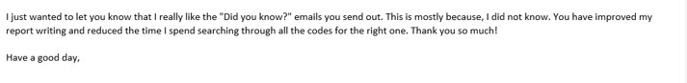
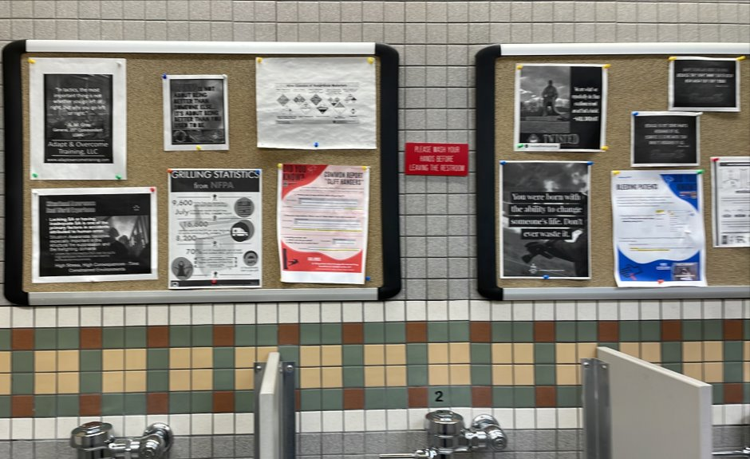
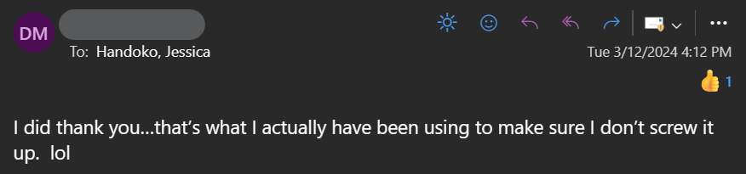
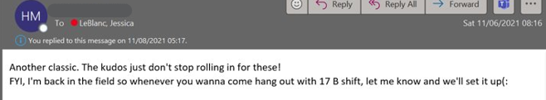

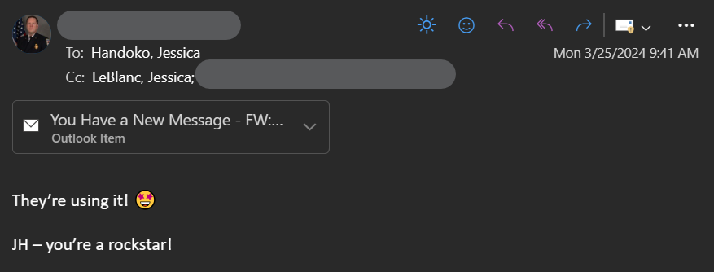
Our Wins!!!
Joining them in the Field Ride-Alongs
Emails hearing back that things work!
Seeing our DYKs in the stations

Slide 10
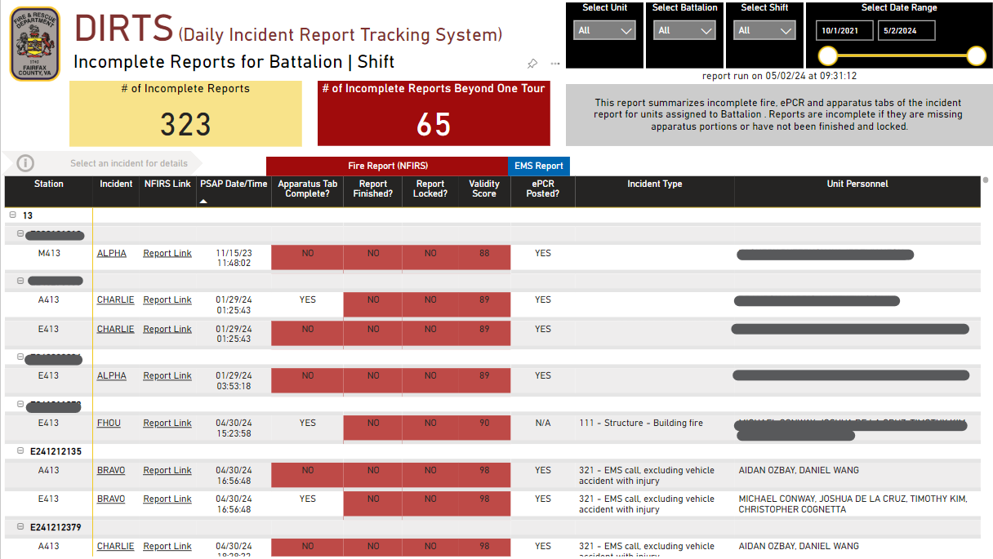
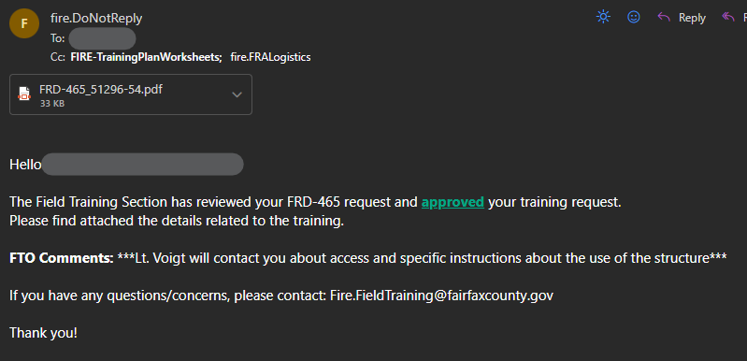
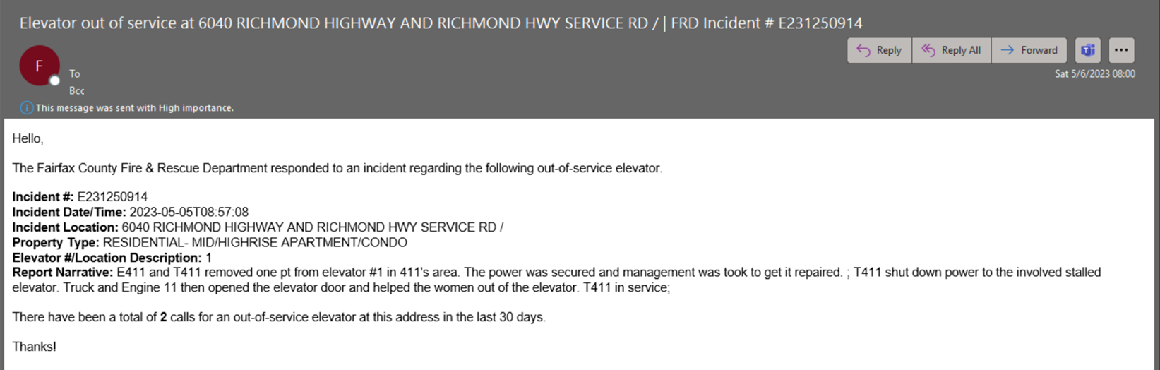
Their Wins!! (The Field)
Ah-ha moments when they learn the “Why?”
LIGHTBLUB MOMENT!!
Improved reporting (not just trying to remove the red)
Getting their time back (food & sleep)
Station 429, elevators incidents → Notifying elevator company
Station 408 lift assists → CRT, connecting them with the right people
Quicker answers through automation
Transparency in the department
Reports to help manage outstanding reports
Before (02/2024)
After (05/2024)

Slide 11
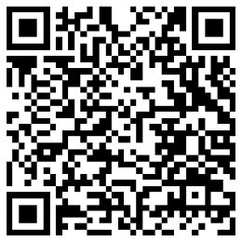
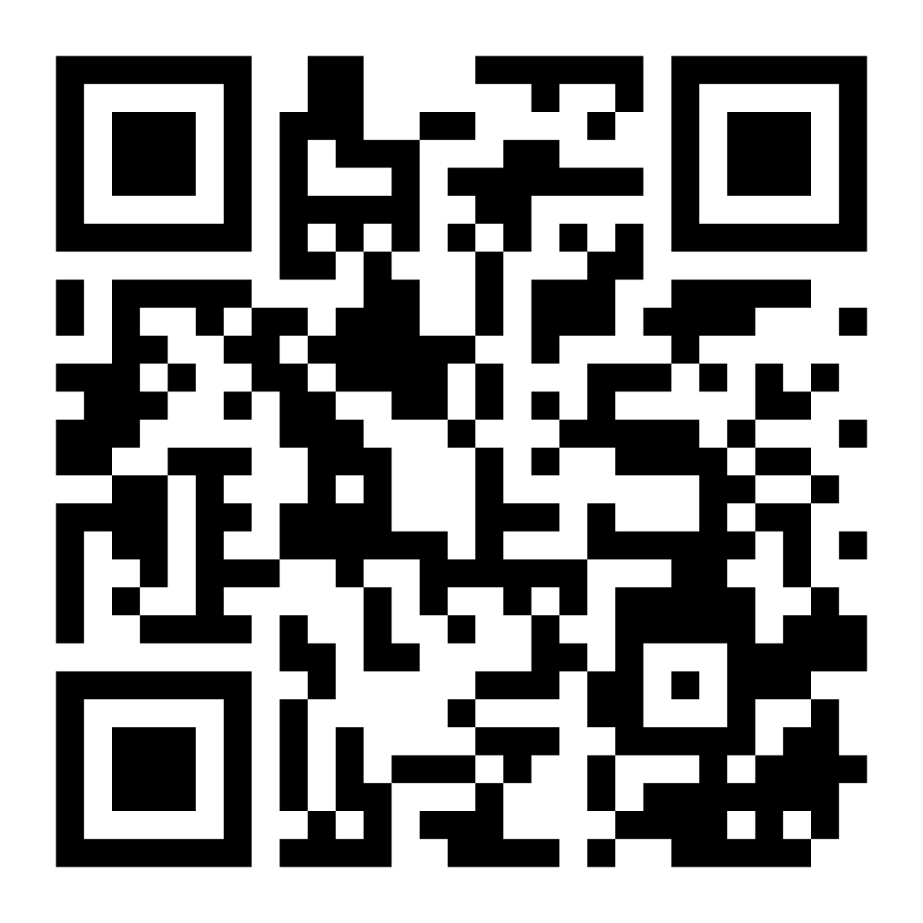
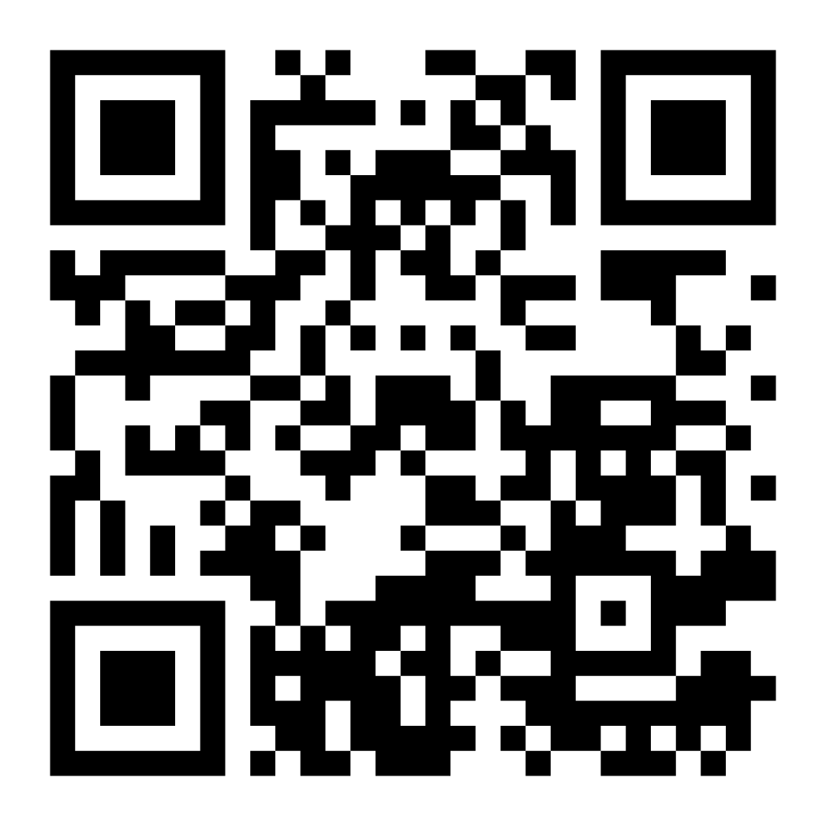


QUESTIONS????
Jessica Handoko
Fairfax FRD GitHub
Fire Analysts LinkedIn Group
amadea.handoko@fairfaxcounty.gov
https://www.linkedin.com/in/ajhandoko/

